Slide 1


Google search console insights
(March 1, 2023 - March 31, 2023)
httpa://nbcypressaesthetics.com

Slide 2
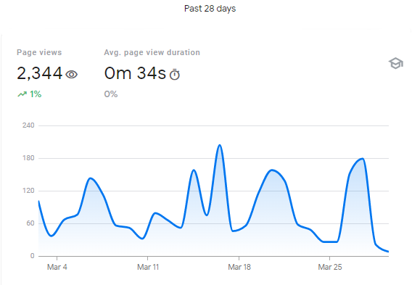
Site Overview
(March 1, 2023 - March 31, 2023)

Slide 3
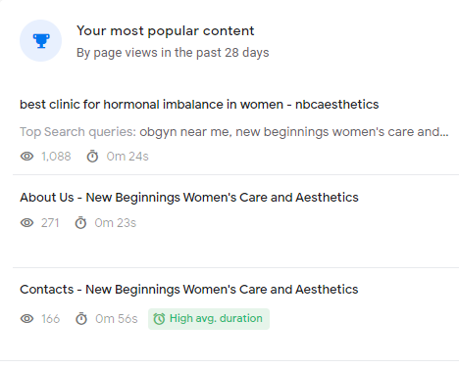
Know Your Most Viewed Content
(March 1, 2023 - March 31, 2023)

Slide 4
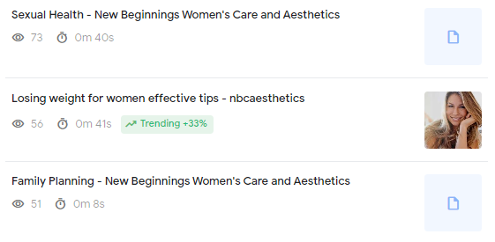
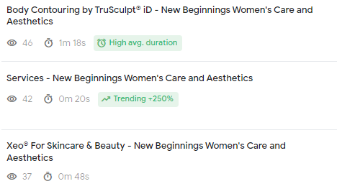
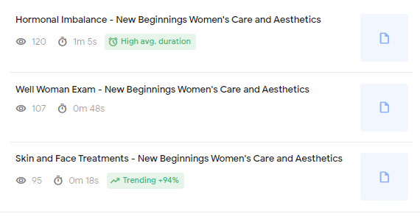
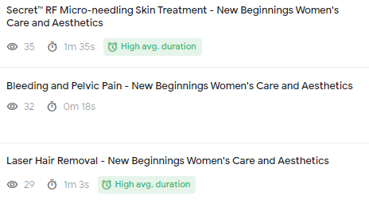

Slide 5
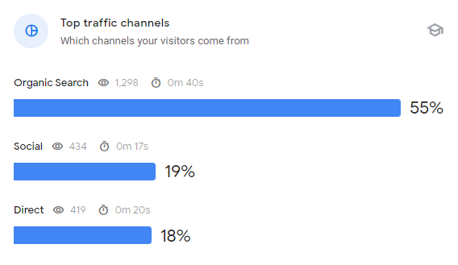
How People Find You
(March 1, 2023 - March 31, 2023)
Organic search increases by SEO

Slide 6
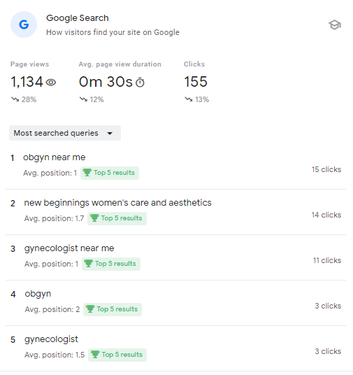
How People Find You on Google
(March 1, 2023 - March 31, 2023)

Slide 7
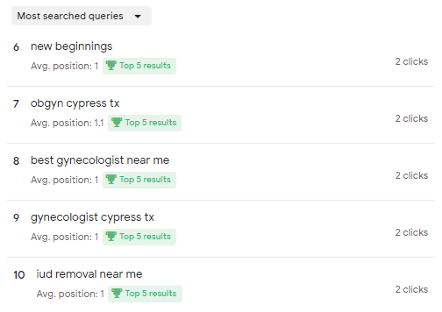
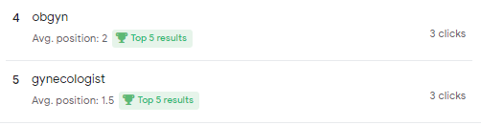

Slide 8
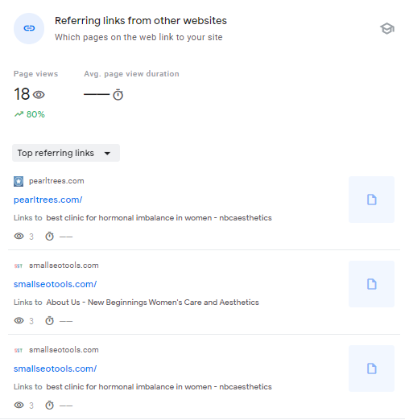
Top SEO Referring Backlinks
(March 1, 2023 - March 31, 2023)

Slide 9
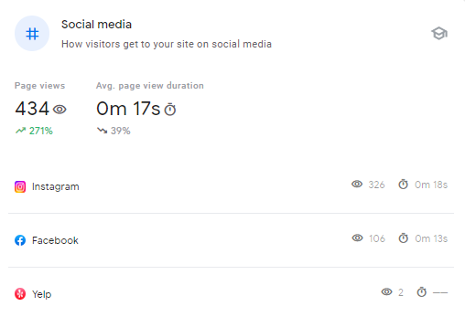
Visibility on Social Media
(March 1, 2023 - March 31, 2023)

Slide 10
Thank You

